Slide 1
Learning Fair Representations (LFR)
VS
Fairness-aware Classifier with Prejudice Remover Regularizer (PR)
Group 3
Aakanksha Agarwal / Lichun He / Shiqi Tang / Vasiliki Vlachou / Huiying Wang

Slide 2

Background
The aim of a fairness algorithm is to avoid the outcome decisions are being made unfairly to certain groups or individuals.
Graph generated from https://www.hrzone.com/perform/people/thats-not-fair-when-individual-deals-challenge-the-fairness-in-teams

Slide 3
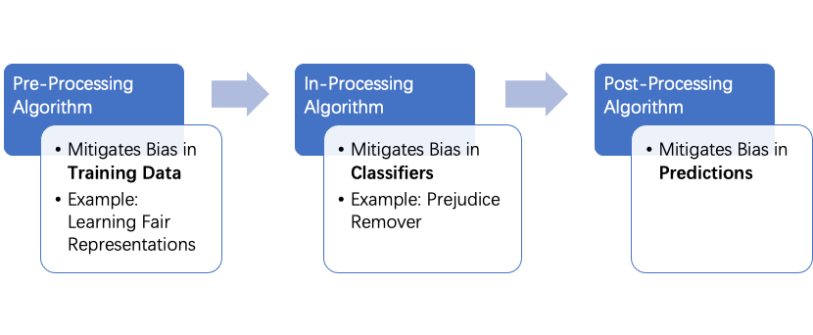
Where can we intervene in the pipeline?

Slide 4
Algorithm 1: Learning Fair Representations¹
A learning algorithm for fair classification that achieves both
Group fairness: the proportion of members in a protected group receiving positive classification is identical to the proportion in the population as a whole, and
Individual fairness: similar individuals should be treated similarly
Learning fair representations is a pre-processing technique that finds a latent representation which encodes the data well but obfuscates information about protected attributes
Maintain the content necessary for a particular task while filtering away sensitive attributes
1: Zemel, R., Wu, Y., Swersky, K., Pitassi, T. &amp; Dwork, C.. (2013). Learning Fair Representations. Proceedings of the 30th International Conference on Machine Learning, in Proceedings of Machine Learning Research 28(3):325-333 Available from https://proceedings.mlr.press/v28/zemel13.html.

Slide 5
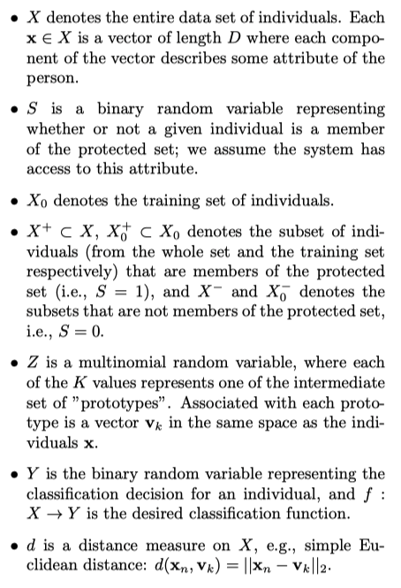

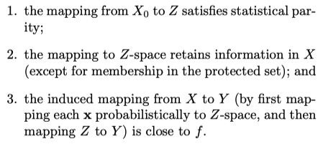
Algorithm 1: Learning Fair Representations (cont.)
Statistical Parity:
Representation as mixture of prototypes:
Learning goals:

Slide 6








Algorithm 1: Learning Fair Representations (cont.)
Objective Function:
Minimize

Slide 7
Algorithm 2:
Fairness-aware Classifier with Prejudice Remover Regularizer (PR)¹
Three causes of unfairness
Prejudice
Understimation
Negative legacy
Prejudice remover is an in-processing technique that adds a discrimination-aware regularization term to the learning objective
Reduce indirect prejudice
Enforce a determination’s independence from sensitive information
1: Kamishima, Toshihiro & Akaho, Shotaro & Asoh, Hideki & Sakuma, Jun. (2012). Fairness-Aware Classifier with Prejudice Remover Regularizer. 35-50. 10.1007/978-3-642-33486-3_3.
Notes:
Prejudice involves a statistical dependence between sensitive features and other information;
underestimation is the state in which a classiﬁer has not yet converged;
and negative legacy refers to the problems of unfair sampling or labeling in the training data.
indirect prejudice is statistical dependence between a sensitive variable and a target variable.

Slide 8





Algorithm 2: (cont.)
Fairness-aware Classifier with Prejudice Remover Regularizer (PR)¹
Parameters are estimated based on the maximum likelihood principle
Objective function:
Prediction model :
Prejudice remover regularizer:
⇒ Objective function:
Notes:
The conditional probability of a class given non-sensitive and sensitive features is modeled by M[Y | X, S; Θ], where Θ is the set of model parameters.

Slide 9
About Dataset - COMPAS: compas-scores-two-years.csv
Data Cleaning
Extract subset of dataset with race "African-American" or "Caucasian" – we are only interested in fairness between these two races.
Remove unuseful columns (columns with multiple missing data).
Remove rows that:
If the charge date of a defendants Compas scored crime was not within 30 days from when the person was arrested, we can assume that because of data quality reasons, that we do not have the right offense.
The recidivist flag (is_recid) should be -1 if we could not find a compas case at all.
Ordinary traffic offenses (c_charge_degree = 'O') will not result in Jail time and hence are removed (only two of them).
We filtered the underlying data from Broward county to include only those rows representing people who had either recidivated in two years, or had at least two years outside of a correctional facility.
Split the Dataset
Split data into sensitive and nonsensitive data (sensitive --> race: Caucasian).
Split data into training, validation, and testing sets (training: validation: testing = 6:2:2).

Slide 10
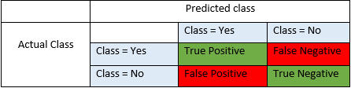
Evaluation Metrics
Accuracy = (TP+TN)/(TP+FP+FN+TN)
F1-Score = 2*(Recall * Precision) / (Recall + Precision)
PS: Precision = TP/(TP+FP) ; Recall = TP/TP+FN
Notes:
https://blog.exsilio.com/all/accuracy-precision-recall-f1-score-interpretation-of-performance-measures/#:~:text=F1%20score%20%2D%20F1%20Score%20is,have%20an%20uneven%20class%20distribution.

Slide 11
Evaluation Metrics (cont.)
Evaluation metrics | Word Description | Formula | Ideal result
Calibration Difference | a difference between the accuracy in the privileged group and unprivilidged group | acc𝐷=𝑝𝑟𝑖𝑣𝑖𝑙𝑒𝑔𝑒𝑑-acc𝐷=𝑝𝑟𝑖𝑣𝑖𝑙𝑒𝑔𝑒𝑑 | 0
Equal Opportunity Difference | a difference between the true positive rate of privileged group and the true positive rate of unprivileged group | 𝑇𝑃𝑅𝐷=𝑝𝑟𝑖𝑣𝑖𝑙𝑒𝑔𝑒𝑑 −𝑇𝑃𝑅𝐷=un𝑝𝑟𝑖𝑣𝑖𝑙𝑒𝑔𝑒𝑑 | 0

Slide 12
Evaluation metrics(cont.)
Evaluation metrics | Word Description | Formula | Ideal result
Average Absolute Odds Difference | using both false positive rate and true positive rate to calculate the bias | 1/2[|𝐹𝑃𝑅𝐷=𝑝𝑟𝑖𝑣𝑖𝑙𝑒𝑔𝑒𝑑−𝐹𝑃𝑅𝐷=un𝑝𝑟𝑖𝑣𝑖𝑙𝑒𝑔𝑒𝑑|+ |𝑇𝑃𝑅𝐷=𝑝𝑟𝑖𝑣𝑖𝑙𝑒𝑔𝑒𝑑−𝑇𝑃𝑅𝐷=un𝑝𝑟𝑖𝑣𝑖𝑙𝑒𝑔𝑒𝑑|] | 0
Disparate Impact | Like Statistical Parity, but we use the ratio of both conditional probabities given a random individual drawn from privileged or unprivileged group with a label of 1 | 𝑃𝑟(𝑌=1|𝐷=𝑝𝑟𝑖𝑣𝑖𝑙𝑒𝑔𝑒𝑑)/𝑃𝑟(𝑌=1|𝐷=un𝑝𝑟𝑖𝑣𝑖𝑙𝑒𝑔𝑒𝑑) | 1

Slide 13
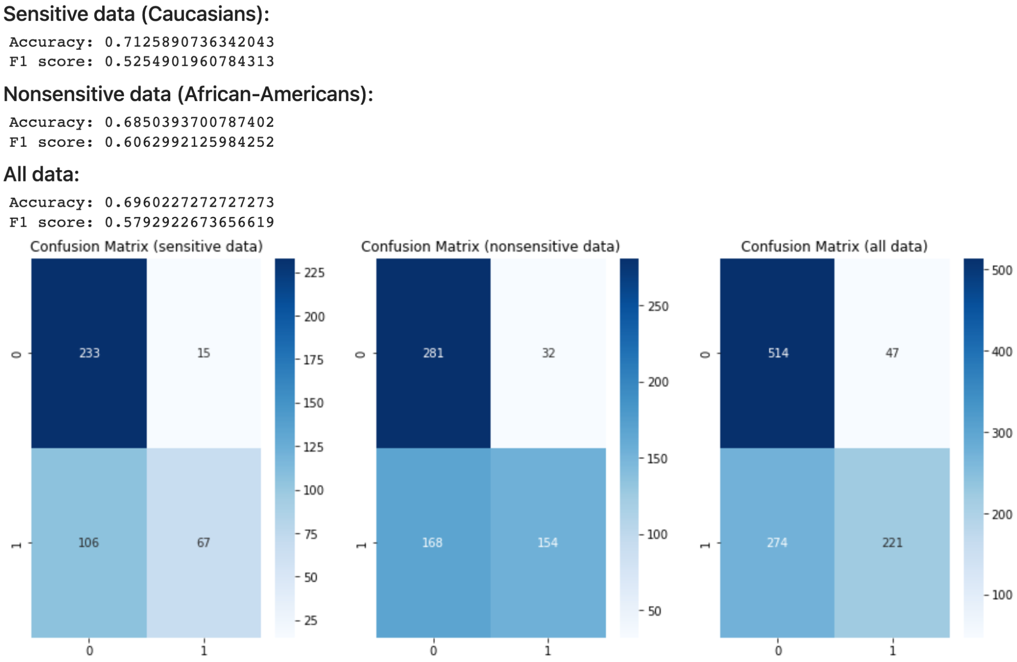
Results - Evaluation of LFR on Test data

Slide 14
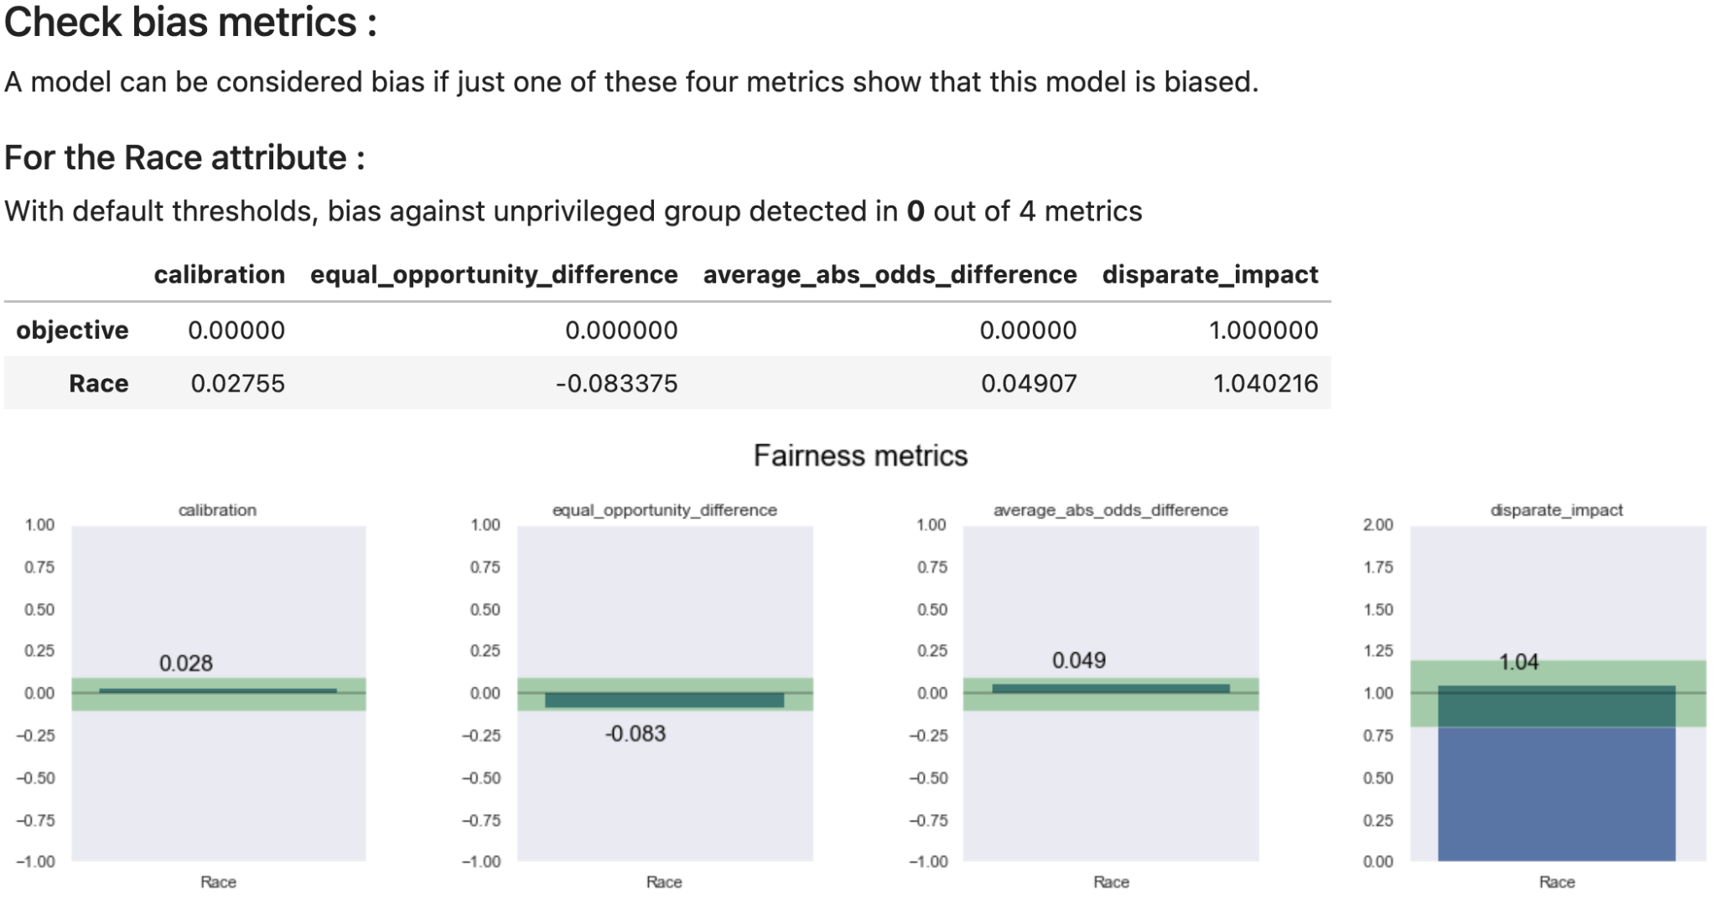
Results - Evaluation of LFR on Test data (cont.)

Slide 15
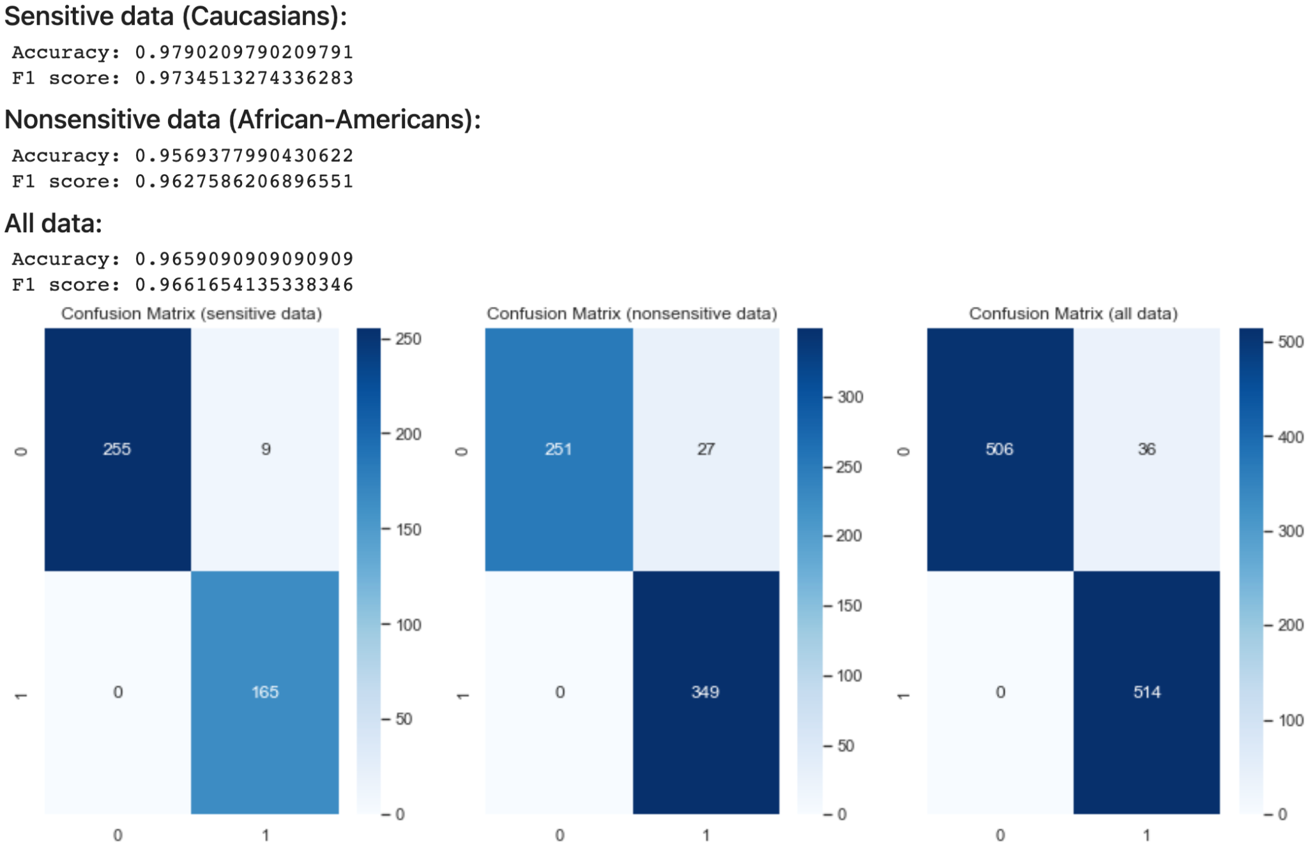
Results - Evaluation of PR on Test data

Slide 16
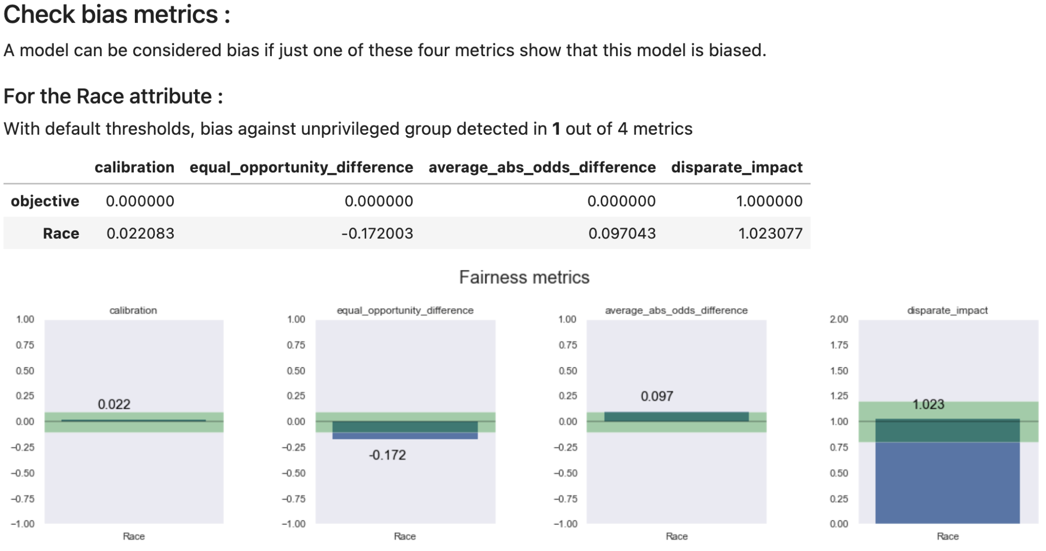
Results - Evaluation of PR on Test data (cont.)

Slide 17
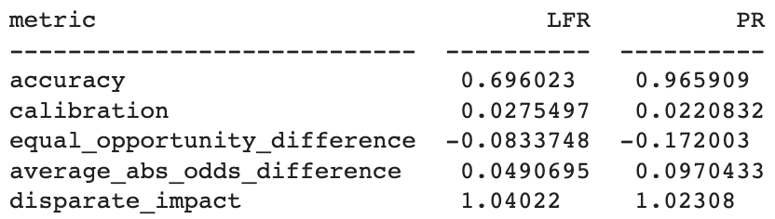
Comparison & Conclusion
PR (A5) model demonstrated better performance in trade-off between accuracy and bias than LFR (A1) model.
PR method is inferior to LFR in equal opportunity difference and average absolute odds difference.

Slide 18
Thank you

